Slide 1
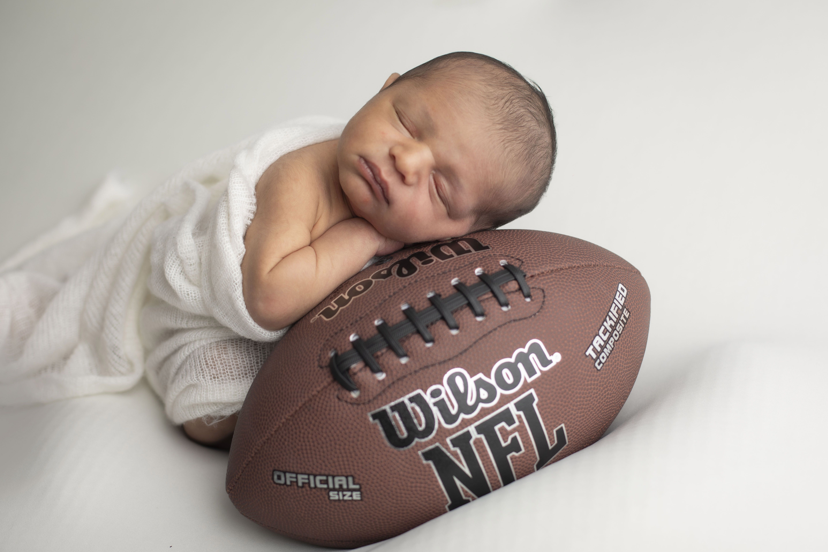
Tackling Transition and Related TRAC-IT Documentation
Kyla Patterson
December 16, 2024
Notes:
Emphasize that requirements and practices have not changed. How and where it’s documented might be a little different …

Slide 2
Poll
This Photo by Unknown Author is licensed under CC BY-SA-NC
Notes:
LSM
SC
Parent of a child in EI
State staff
Provider
More than 1 role

Slide 3
Choose a photo that conveys how you feel when you hear or think about requirements related to transition:
Poll
a.
b.
d.
c.
e.

Slide 4
Purpose
Support smooth transitions for children and families
Notes:
As we talk today about the transition requirements and figuring out how to implement those requirements and document the work in TRAC-IT, I think it’s important to remember that the purpose behind the federal and state requirements related to transition and behind the transition section of our IFSP is to ensure each child and family receives the support they need for a smooth transition when they’re leaving EI (regardless of age and transition destination). That purpose should be what anchors us, what we come back to, when we’re trying to figure out how to implement the requirements for transition in a given scenario.
Let’s use the transition section of the IFSP to guide our discussion of the transition requirements and documentation.

Slide 5
Important Dates for Transition Planning
Initial IFSP – All Children
Share general information
What transition means
Possible timing
Important dates for transition planning with this specific child and family
Target date for notification and referral to transition at age 2
Date of third birthday
Notes:
Going to transition somewhere between those dates depending on decisions made later by the family. The purpose is to give the family an idea about when transition might occur. There is no commitment here … it doesn’t matter whether the family is interested in going to Part B or how old the child is. You’re saying … Just to give you an idea, if you decide you’re interested in preschool services through the school system, then in Virginia your child would be age eligible at the start of the school year in 2025 and we would need to be notifying the local school system by April 1 of that year. Otherwise, if your child remains eligible for EI services, then he could continue to receive those services until his third birthday. As your child gets older we’ll talk more about your specific plans and figure out exactly where in this window of time transition will actually happen.​

Slide 6
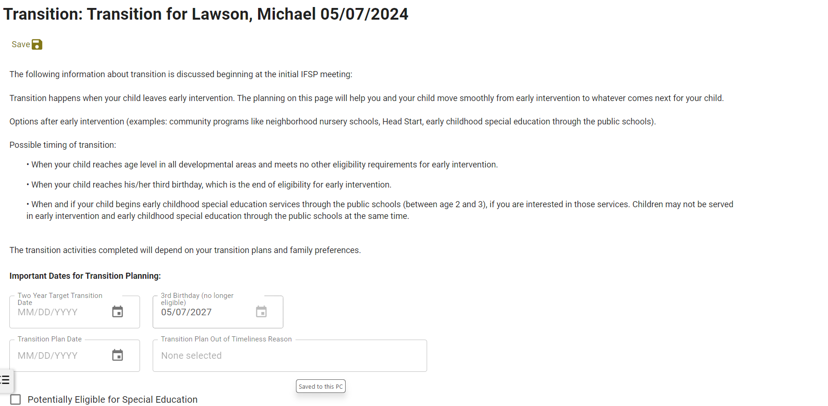
TRAC-IT: Important Dates at Initial IFSP
Notes:
This is in the Transition Plan task. Gives you the info to review with the family at the top.
Target date for transition at age 2: This date must always be at least 90 days before the anticipated date of transition. Generally, local systems will enter April 1 of the year that the child will be 2 by September 30th. This date provides the target date for notification and referral to the local school division for the child to begin receiving early childhood special education services on the first day of school. Some local systems may work with local school divisions that allow admission of 2-year-olds throughout the school year (rolling admissions) or have other agreed upon timelines for referral. In that case, enter the target date here accordingly. SEE PM
Hover over calendar icon in the box for the Two Year Target Transition Date and it will show you a reminder about what this date should be
Third birthday will be pre-populated in TRAC-IT

Slide 7
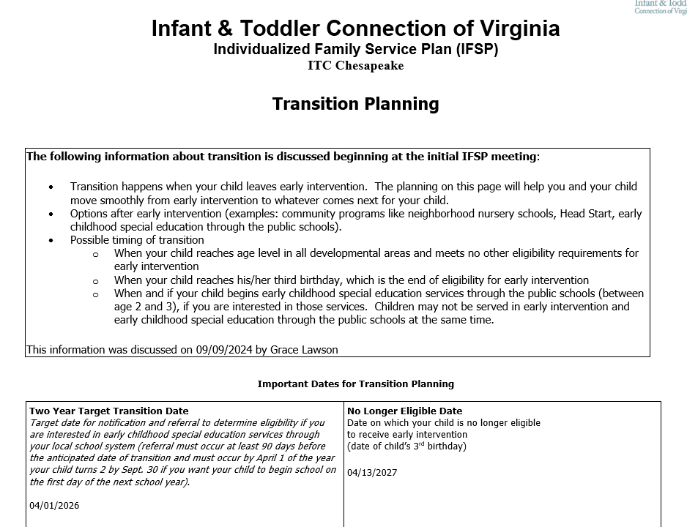
IFSP: Important Dates at Initial IFSP
Notes:
The signed date of the first IFSP in which “transition planning was discussed” is selected

Slide 8
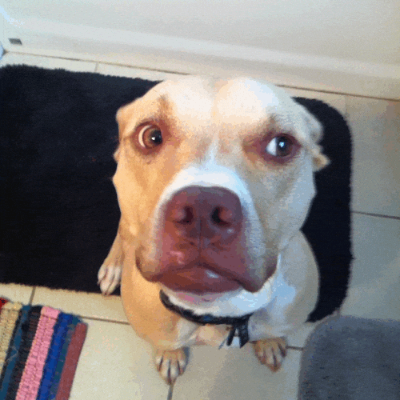
Have you started the transition plan at this point?
Check Your Understanding
Notes:
So do not enter a transition plan date.

Slide 9
What Comes Next?
Notes:
With these early conversations, you’ve given the family a general idea about what transition is and when it might occur. After that, the timing for further planning and the specific steps and activities that must be addressed and documented will depend on a series of IFSP team and family decisions.​

Slide 10
Potentially Eligible for Part B
Children in early intervention are considered “potentially eligible” for Part B unless there is a clear expectation that they will no longer require services by the time they reach age 3.
The determination of whether a particular child in early intervention is potentially eligible for Part B is made by that toddler’s IFSP team as part of the transition process.
Notes:
As you discussed with families at the initial IFSP, you’re generally going to be planning for transition at age 2 or age 3. So which will it be? The first decision that needs to be made is whether the child is potentially eligible for Part B.
Read info on slide
At least 90 days and up to 9 months before the child becomes age eligible for Part B services at age 2, determine with the IFSP team whether the child is potentially eligible for Part B services.
If the child is not potentially eligible, then re-visit the transition discussion as the child approaches his or her third birthday.

Slide 11
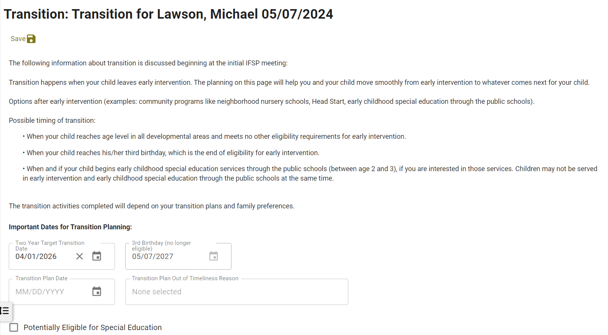
TRAC-IT: Potentially Eligible
Notes:
If the team determines the child is potentially eligible for Part B, check the box in the transition plan task in TRAC-IT (using the Update Transition Plan ad hoc task if needed).
Question: Do you check the box if the team determines the child is potentially eligible but the parents aren’t interested in their child transitioning to school?

Slide 12
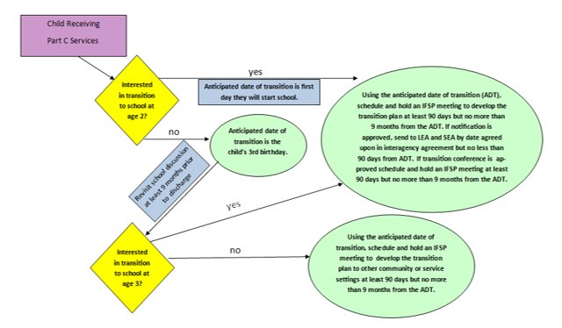
Family Decision Point
Notes:
If the child is potentially eligible, then ask the family if they are interested in considering transition to preschool special education services through the local school division at age 2.
If the family is not interested, then re-visit the transition discussion as the child approaches his or her third birthday.
If the family is interested, proceed with the transition activities

Slide 13
Have you started the transition plan at this point?
Check Your Understanding
Notes:
You do not enter a transition plan date in TRAC-IT just because you had a conversation with the family about potentially eligible and their interest in transition at age 2.

Slide 14
Child is Potentially Eligible for Part B
Transitioning at age 2 or age 3

Slide 15
Now It’s Time!
Potentially Eligible: Transition Plan
Notes:
Either the child is approaching transition at age two, is potentially eligible and the parent is interested in transitioning or the child is approaching transition at age 3 and is potentially eligible. Now it’s time to develop the transition plan. This will happen at an initial, annual or IFSP Review meeting to develop the transition plan. And, remember, the plan must be developed at least 90 days and up to 9 months before the child transitions out of EI.

Slide 16
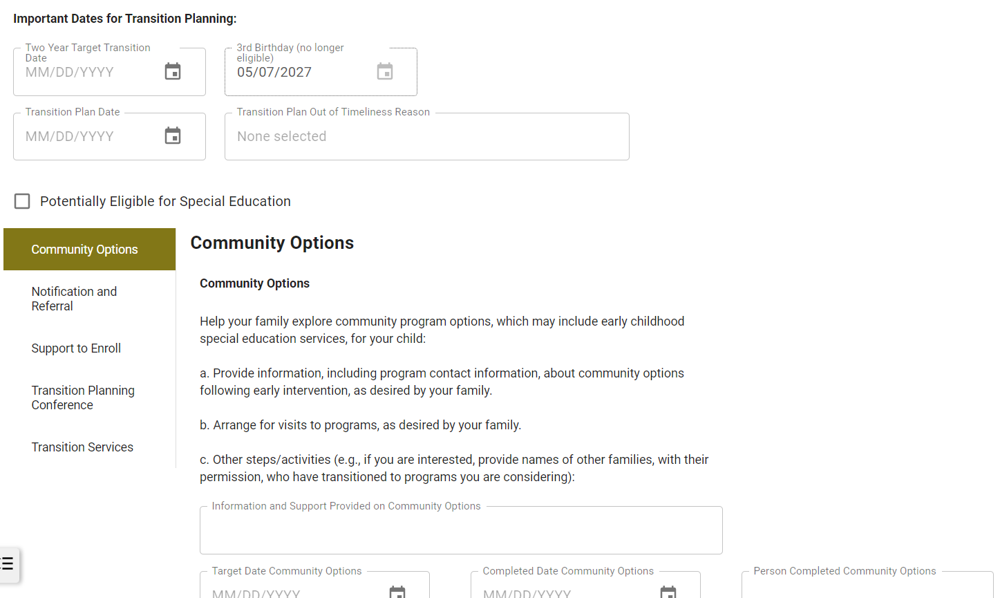
Transition Plan: TRAC-IT
Notes:
Now you will fill in the transition plan date in TRAC-IT … the date of the IFSP meeting or IFSP Review meeting at which you are developing the plan. If you know you are outside of the 90 day to 9 month timeline, then you can go ahead and select a reason (see blue circle). Fill it in now … while the reason is fresh in your mind. That’s much easier than trying to figure out whether you need a late reason at discharge and what the reason was.
You will then enter information for the transition plan activities in the section below the circled fields. The transition steps and activities that will be completed for an individual child and family will depend on that family’s specific transition plans and preferences. The steps and activities may be completed in whatever order is most appropriate for each child and family. Let’s look at those steps and activities now.

Slide 17
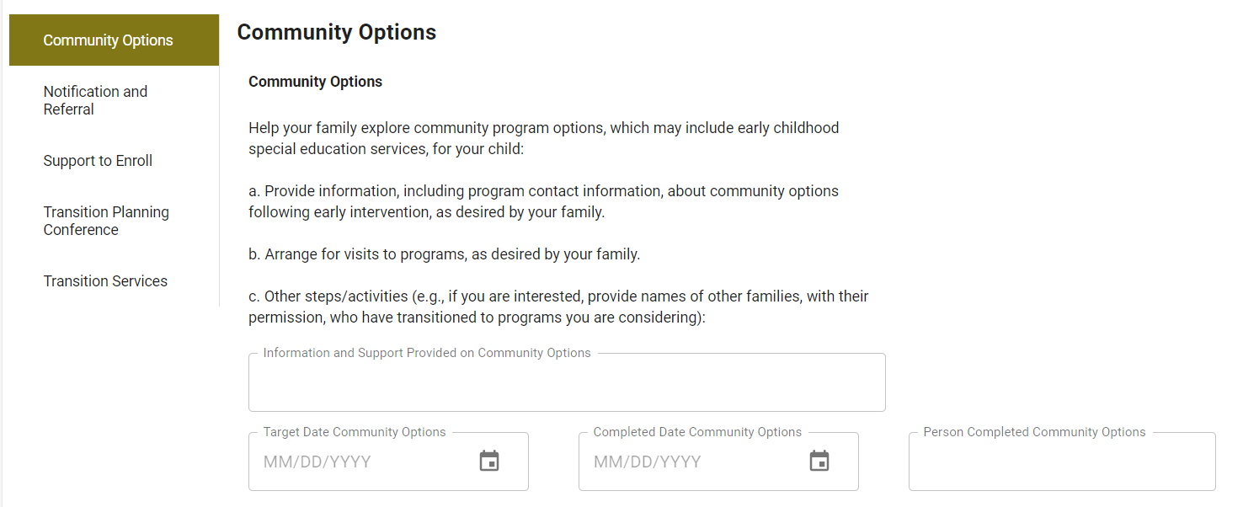
Community Options
Notes:
Community options: This step is generally going to be your starting point in developing the plan and is applicable for all families. What community options, including early childhood special education services, is the family interested in exploring and hearing about? Maybe they would like to hear about several. Maybe they already know they want to go to the school system. Maybe they’re not interested in hearing about any community options. Those are all fine responses, and you’ll fill in the blanks in TRAC-IT based on the family’s decisions. If the family is not interested, then write that. This step in the transition plan is applicable for all families, so N/A should not be used and it should not be left blank.

Slide 18
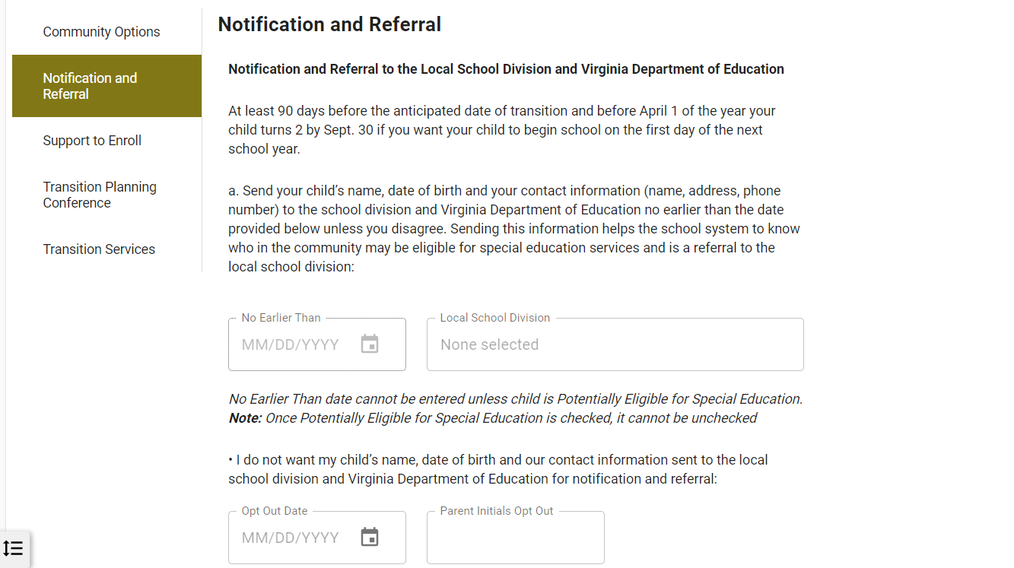
Notification
Notes:
We know this federal requirement, right? Children who are potentially eligible for Part B must be referred (notification sent) to the local school division and Virginia Department of Education at least 90 days before the child’s third birthday. Since children in Virginia can start preschool special education at the beginning of the school year in which they are two by Sept. 30, we say “90 days before the anticipated date of transition” to include those transitioning at age 2. As noted in the text on the screen from TRAC-IT (and on the IFSP), children transitioning at age 2 should be referred by April 1 in accordance with our state interagency agreement, unless you have agreed to a different timeline in a local written agreement. When you’re developing the transition plan in TRAC-IT, you’ll enter the no earlier than date and the name of the local school division in this step. NOTE: Users will be unable to enter a “no earlier than date” for the transition notification until the “Potentially eligible for Special Ed” box is checked … this ensures all necessary information is provided to trigger notification and referral to VDOE, which we’ll discuss further in a minute.
The family can opt out here as well. If the family opts out, additional boxes will appear in case the family changes their mind later.

Slide 19
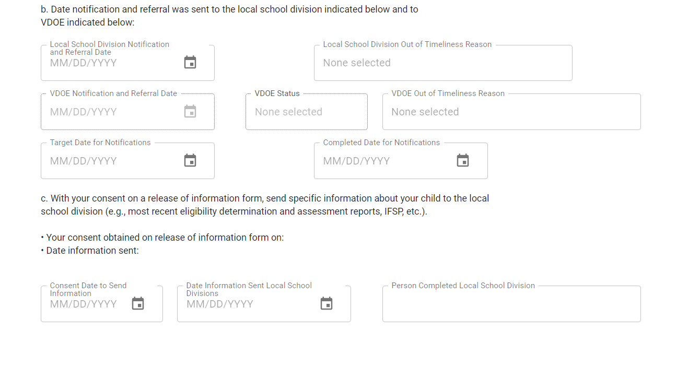
Notification
Notes:
Continuing in the Notification and Referral Step… b is where we record when the actual notification was completed. If you know that either of the required notifications (local or state) occurred less than 90 days before the child’s third birthday or anticipated date of transition at age 2, then you can select the reason it was not timely. Finally, c is where you document steps you took for sending child-specific information (like assessments and IFSPs) to the local school system to support transition.
Before we move on to the next step in the transition plan, let me talk a little bit about notification to VDOE …

Slide 20
Notification to VDOE
Potentially Eligible for Special Education box checked
“No earlier than date” and Local School Division filled in
There is no date in the Opt Out field or if there is a date in the Opt Out field, there is also a date in the Opt In field
The child will populate to the state office’s DOE Notification Extract when they reach the notification "no earlier than date“
Notes:
Works with selection of Save or Complete

Slide 21
Notification
Notes:
VDOE Notification and Referral Date auto populates
Explain VDOE status – Also auto populates … Pending (info is complete but waiting for “no earlier than” date to arrive) or Complete (sent)
If using an EHR upload for the transition information, you can send the info that prompts the state office to do the notification to VDOE –OR – if you do the VDOE notification yourself, your EHR upload can include the VDOE notification date and VDOE notification status of “Complete”

Slide 22
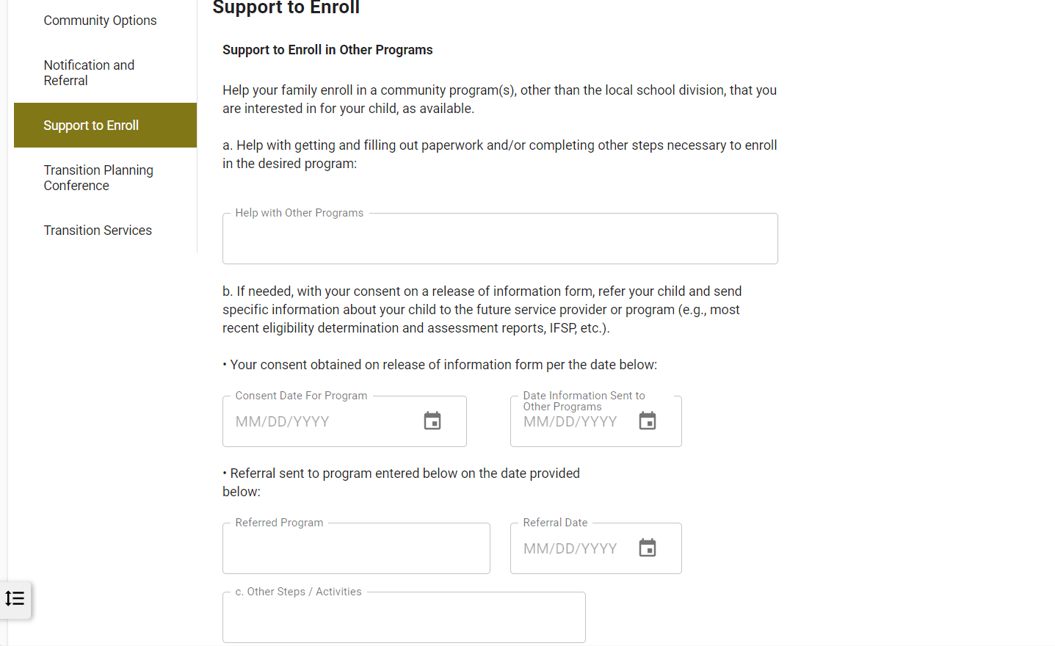
Support to Enroll
Notes:
This step is applicable to any child whose parents are interested in enrolling their child in a community program other than or in addition to the local school system
In Step a, document any assistance the family would like you to provide to help them enroll in the desired community program
In Step b, document the date of consent to send a referral to a community program other than the local school system, the name of the program, date referral sent, and date any additional information was sent
In Step c, document any other steps and activities planned in order to support the child and family becoming enrolled in a desired community program other than the local school system.​
The support described in this step should be offered to all families. If they are not interested, write that. Then indicate N/A in any other non-date fields that follow from the family decision. ​

Slide 23
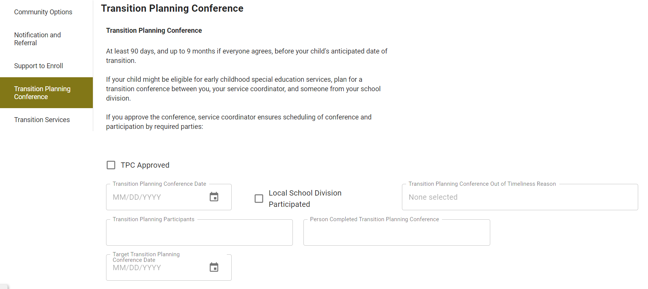
Transition Conference
Notes:
This step addresses the transition conference. For children who are potentially eligible for Part B, a transition conference is required (as long as the parent approves), and that conference must be held at least 90 days and no more than 9 months before the child’s anticipated date of transition (either at age 2 or age 3). In addition, the conference must meet the requirements of an IFSP meeting.
For the conference, when we talk about it being required with parent approval … do we require written approval or do we allow verbal approval. Type in the chat.
If the parent approves the conference, enter the date it was held, indicate if a local school division representative participated and then list who participated, etc.

Slide 24
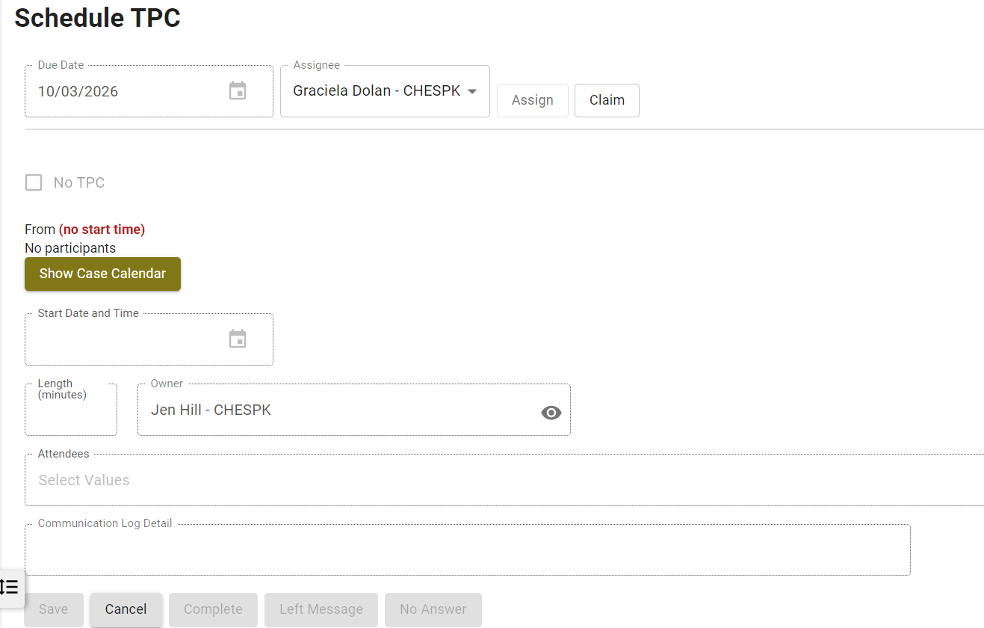
Schedule TPC
Notes:
In TRAC-IT , you must also complete the Schedule TPC task. If the parent does not approve the conference, mark the No TPC box.

Slide 25
No Part B Rep
Provide information about services available
Discuss difference in scope between Part C and Part B
Contact name and phone number where family can call with questions
Document
Notes:
Remember, the school system rep must be invited. In that rare instance when the local school division representative cannot participate in any of these ways, the local Infant & Toddler Connection system holds the conference without the school system. Must provide parents at the conference with general information about early childhood special education services through the local school system, including a description of the Part B special education eligibility definitions, timelines and process for consenting to an evaluation and conducting eligibility determinations under Part B, and the availability of special education and related services. Discuss the difference in scope between the two programs (Part B and Part C), including how Part C services and supports are child and family centered while Part B services are student-specific with parent involvement. The local school division must provide the family with a contact name and phone number where the family can call with questions about school services.
If the local school division does not respond or fails to attend the transition conference, the service coordinator must document:
The method (phone call, email, text, etc.) used to coordinate with the local school division;
The number of attempts to schedule the transition conference;
The date(s) the invitation to the transition conference was sent to the local school division; and
The lack of response

Slide 26
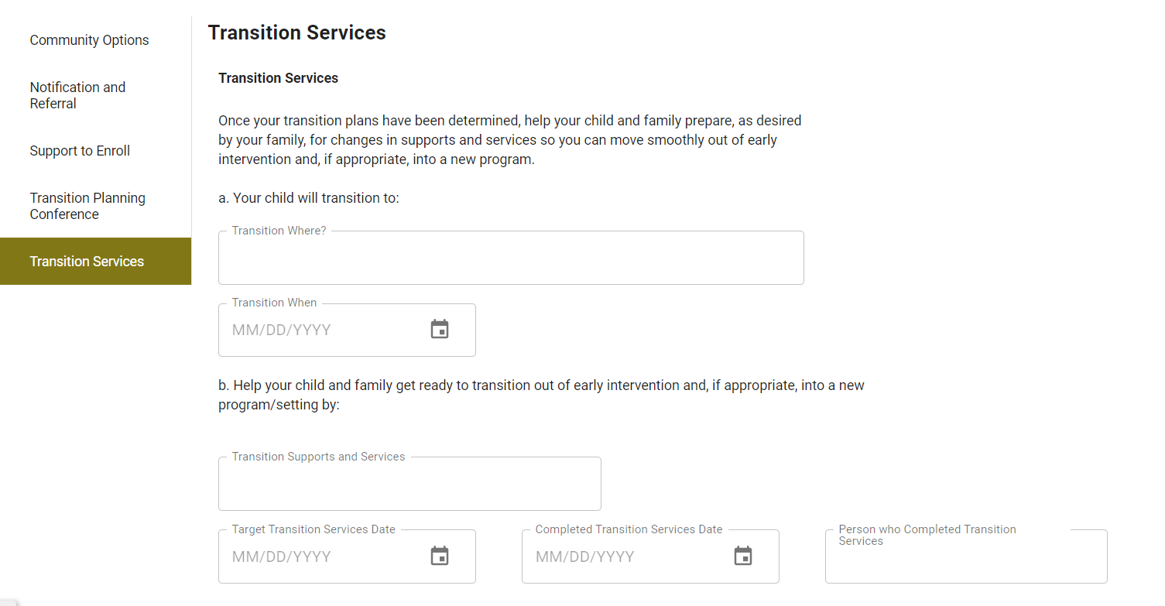
Transition Services
Notes:
Getting back to the transition plan task in TRAC-IT … The final step to address in the transition plan task is Transition Services. This step is applicable to any child and family and should reflect what the local Infant & Toddler Connection system will do to assist the child and family to prepare for the transition. This may include steps to help the child become more familiar with the new program/setting and/or learn new skills needed to adjust to the new program/setting (e.g., working on specific IFSP outcomes that will help the child adjust to the new setting like climbing stairs, communicating wants and needs, or social skills). For a child who spends most of his/her time at home, the IFSP team may need to consider expanding the location of services to assist the child in adjusting to a group setting, riding the bus, etc. This may also include steps to assist the family in determining and completing other activities that are needed before the child can move into the new program/setting (e.g., enrollment forms, immunizations, transportation issues, etc.). For children who are not entering a new program/setting, transition services in Step b may include providing the family with information and resources to continue monitoring and supporting their child’s development, providing links to community resources they may find helpful in the future, or other supports and services ​
If the family is not interested, write that.​

Slide 27
Minimum Required Fields for Transition Plan
Transition Plan: Required Fields
Community options
Support to Enroll
Transition Supports and Services
Notes:
It is not necessary to fill out the information for all steps at the initial meeting to develop the transition plan, though all steps should at least be mentioned and reviewed so the family understands the kinds of transition steps and services included. However, once you enter a transition plan date, you must have info in
Community Options – text field
Support to Enroll – Help with other programs
Transition Services – Transition supports and services
Error message will remind you if one of these is missing.
Options:
Enter the Transition Plan date, fill in information for the activities that were discussed/planned and SAVE the task. You can then go back and fill in the other transition plan activities over time; OR
Enter the Transition Plan date and write something in all the other required fields. For those activities where you did not make specific plans with the family, you can write something to indicate you reviewed briefly and will revisit at next IFSP review meeting or not interested yet or will discuss closer to transition. Then you can click COMPLETE and use the Update Transition Plan ad hoc task to revise later
These minimum fields apply to all children whether potentially eligible or not

Slide 28
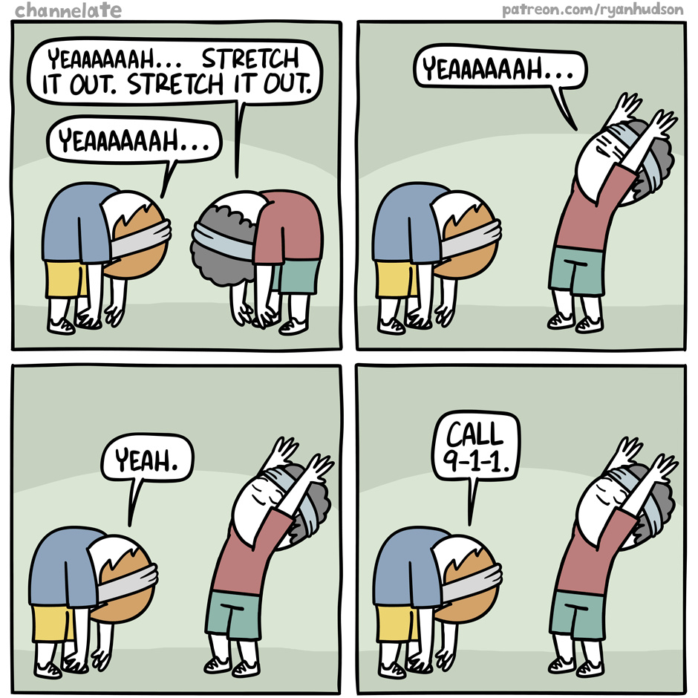
Time to move
Notes:
You can stand or stay seated. As a group, perform 8 shakes of the right arm, 8 shakes of the left, 8 shakes of the right leg, and 8 shakes of the left leg. Each time count each shake as a group from one to eight. Invite everyone to do a signature move – whatever feels right for them

Slide 29
Child Not Potentially Eligible for Part B
Transition at age 3

Slide 30
The same except …
Not Potentially Eligible
Do not mark potentially eligible
No notification and referral
Transition conference
Notes:
Since the child is not potentially eligible for Part B, the potentially eligible box in TRAC-IT will not be checked and the Notification and Referral and Transition Planning Conference will be left blank. This is a change. We used to require that all blanks be filled with N/A, but now that the potentially eligible box exists, we will leave these blank.
Minimum required steps/fields are still the same: Community Options, Support to Enroll, Transition Supports and Services.
Remember: Inform the family that the local Infant & Toddler Connection system will, with parent approval, make reasonable efforts to convene a transition conference among the local Infant & Toddler Connection system providers, the family and community programs of interest to the family (e.g., head start, preschool/child care programs) to discuss appropriate services the child may receive. The offer to hold a transition conference, the family’s decision to approve or not approve such a conference and the completion of the conference if the family approved must be documented in Step 1a or 1c in Section VII of the IFSP. The Schedule TPC Task in TRAC-IT can be used to schedule the conference.

Slide 31
No Longer Eligible/Parent Withdraws/Family Moving out of Virginia
Other Scenarios
Community options
Support to Enroll
Transition Supports and Services
Notes:
Indicate not interested if they’re not.
[If child is over 24 months at discharge and had an IFSP developed, TRAC-IT requires either a transition plan date and the minimum required fields or a reason]

Slide 32
Transfer Between Local Systems
Sending system: transition plan
Transfer
Receiving system: view old, create new
Notes:
Sending local system – prior to discharge, could complete/edit transition plan to reflect moving to another local system in Virginia
Receiving local system – can see the transition plan developed by the previous local system (if there was one), but cannot edit it. Create a new one (might need new local school system, notification/referral; could be new conference; some activities you could type “This step completed by _____ local system. Family not interested in additional support.” If outside timelines – family scheduling preference
Must also complete a new Schedule TPC task

Slide 33
Transition Prompts at Discharge
Review reasons entered
Click Complete to see required
Notes:
If you entered late reasons in the transition plan task, they will show at discharge (editable).
Click Complete and see what’s required

Slide 34
Discharge: Transition Plan
For children over 24 months who have an IFSP developed, TRAC-IT requires either a transition plan date and the minimum required fields OR a reason why the transition plan did not occur. If the date entered is not timely, a reason will be required.
Notes:
What if no transition plan yet (family sched, lost to contact, age of child) and child is being discharged?? Can use family scheduling preference (not interested at age two and then left before 34 months old) or lost to contact

Slide 35
Discharge: Notification
LEA Notification
VDOE Notification
LEA timeliness reason code is required at discharge if the child is potentially LEA eligible and the LEA referral date is less than 90 days from child’s 3rd birthdate, or the LEA referral date is blank but the guardians have not opted out of the notification and referral
VDOE timeliness reason code is required at discharge if the child has an IFSP developed, is potentially eligible, and VDOE notification date is less than 90 days prior to the toddler’s third birthday, or it is blank but the guardians have not opted out of the notification and referral

Slide 36
Discharge: Transition Conference
A TPC date or a TPC timeliness reason code is required at discharge if the child had an IFSP developed and is potentially LEA eligible, unless the “No TPC” box was checked indicating the parent declined the TPC.
A TPC reason code is required if the TPC date is either less than 90 days or greater than nine months prior to the toddler’s third birthday (not within the 27-33 months range)

Slide 37
Print Template
Print from Documents tab to get IFSP with transition pages
Notes:
There are two places to find the IFSP Print Template – in the IFSP entity and in the Documents tab. The print template included in the Documents tab will have the complete IFSP. There was a recent update
that when an IFSP Review is completed, the print template generated is a complete IFSP, including the review pages as well as the IFSP (including the transition and signature pages).

Slide 38
Reminders: Transition to Part B
Responsible for Part C requirements
Do not refer for screening
Notes:
1. Regardless of what the local school division offers or the extent to which they “accept” a referral or participate in a conference, local Part C systems must meet the Part C transition requirements.
2. We are sending a notification and referral and should use that wording. Using the word screening creates confusion. Screening is not something allowed in Part B after referral.

Slide 39
Questions

